Slide 1

Transfer-Matrix Abstraction To Analyze The Effect Of Manufacturing Variations In Silicon Photonic Circuits
Team: Carlos Gonzalez
Faculty Advisors: Dr. Priyank Kalla,
Dr. Angela Rasmussen

Slide 2

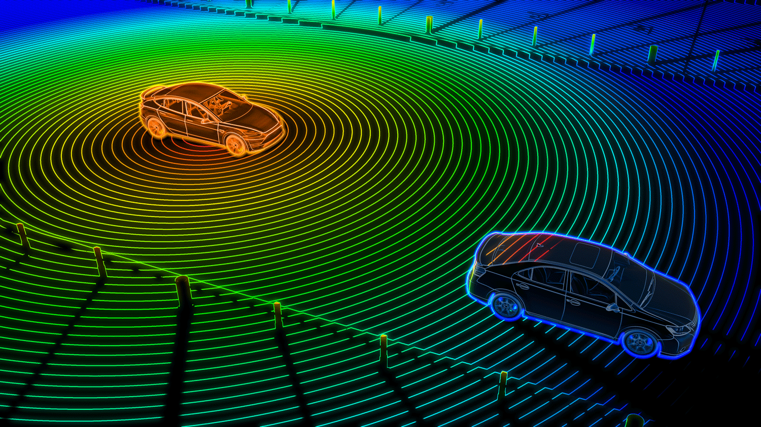
Motivation
The emergence of Silicon (Si) photonics necessitates the development of automated testing and validation techniques/tools.
Si photonics have widespread applications in fields such as communication, signal processing, quantum, reversible computation and optical sensing.

Slide 3
Background Info
Silicon waveguides are transparent to telecommunication wavelength range enabling them to guide the transmission of a wave in the medium.
Silicon and silicon dioxide are ideal for constructing optical waveguides given the large refractive index contrast between the two, we focus on transmission at 1550nm.
We can represent optical systems with transfer matrices.

Slide 4
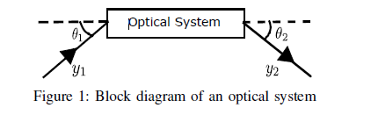
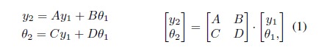
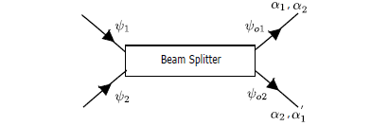
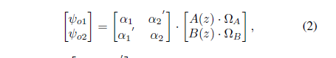
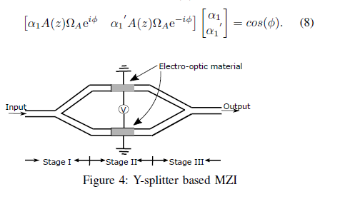
Optical Systems & Transfer Matrices

Slide 5
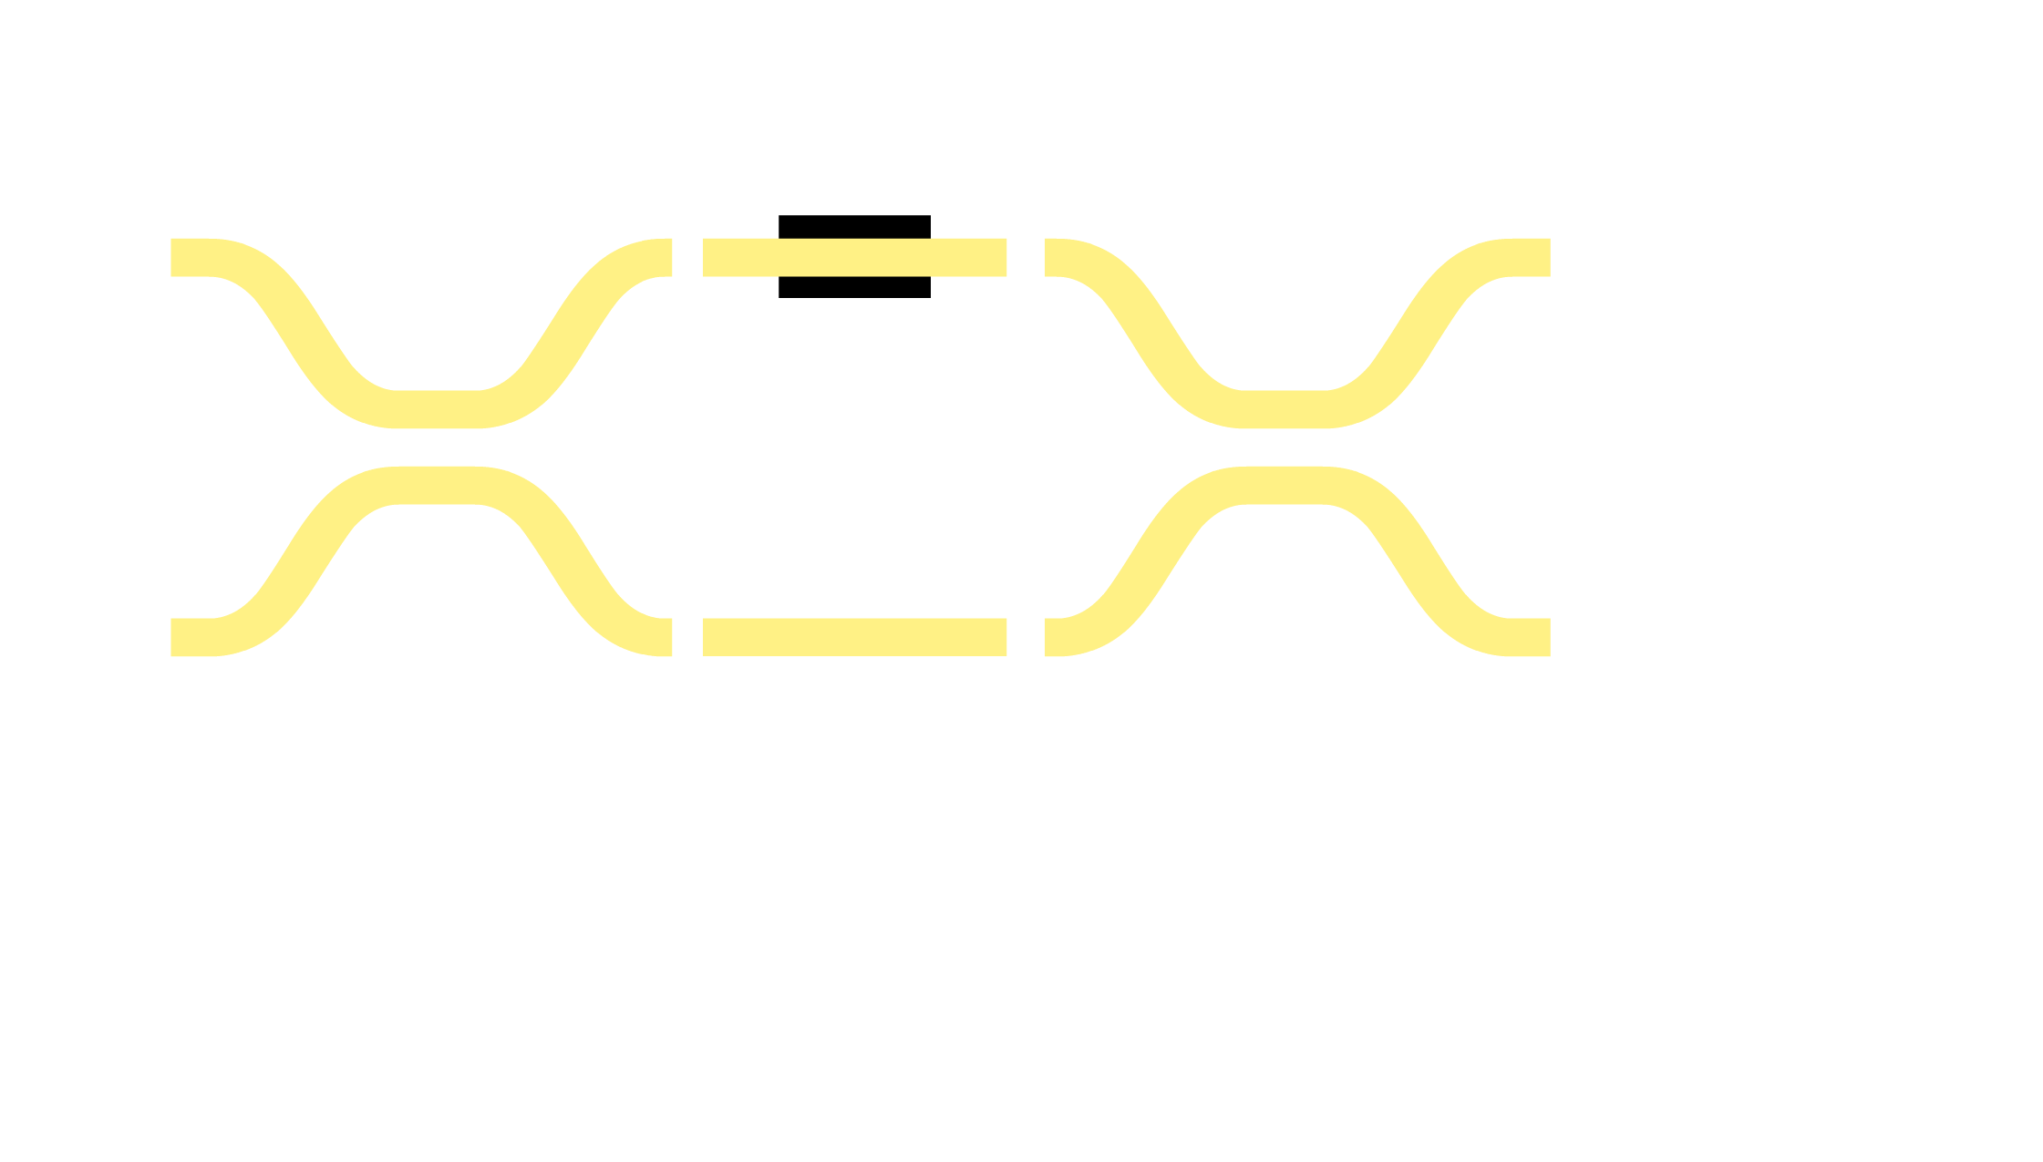




Mach-Zehnder Interferometer (MZI)
S = 0 → Δφ = π → bar
S = 1 → Δφ = 0 → cross

Slide 6
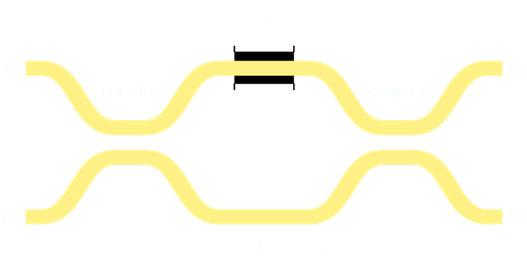
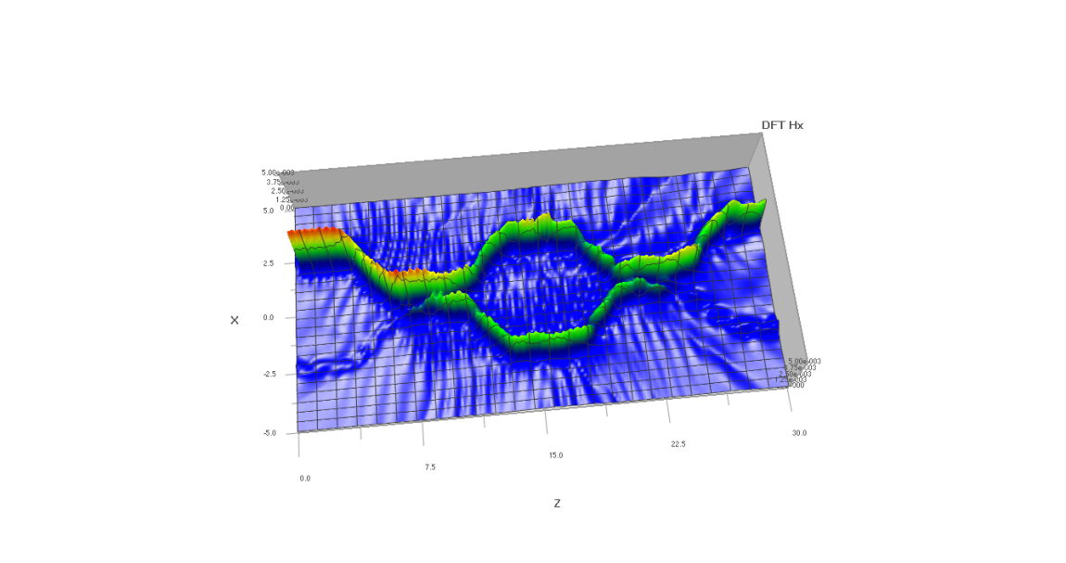
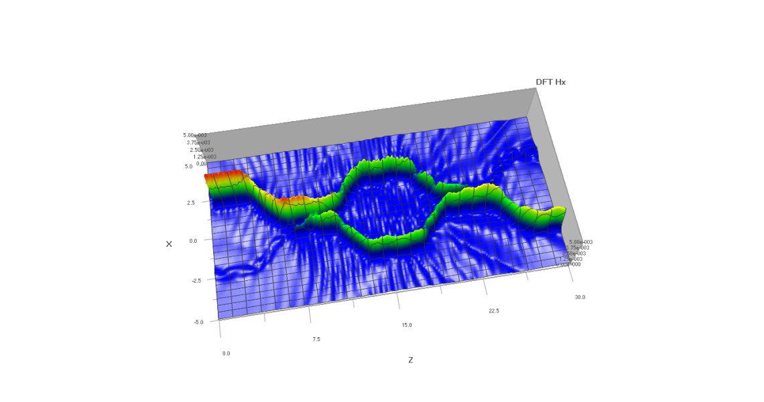
Crossbar Gates – Logic Building Block
Electrically controlled 2x2 Optical Router (“switch”)
s = electrical primary input
a, b, c, d = optical waveguides
Crossbar Gate
S = 0 (bar) → (a = c, b = d)
S = 1 (cross) → (a = d, b = c)

Slide 7
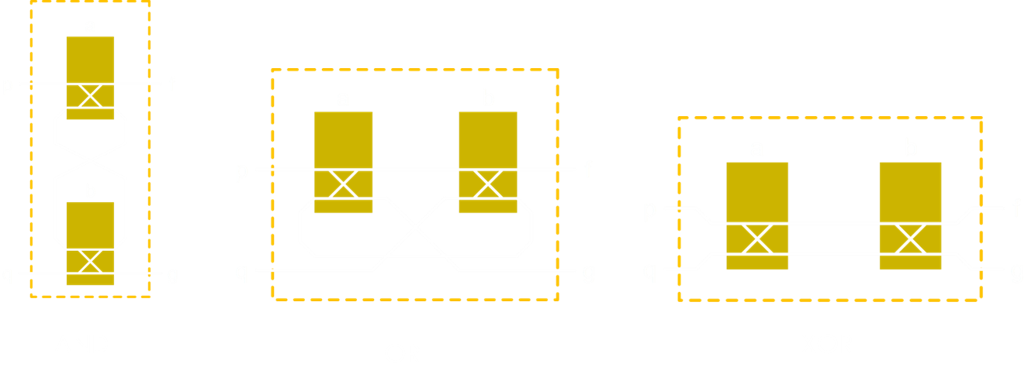
Virtual Gate Operators

Slide 8
Goals
Create a python program that can simulate and run silicon photonic circuits using a more structured procedure. User’s can also use the virtual gates as “building blocks” to build photonic circuits.
Create a file format to store and read optical photonic circuits.
Create debug tools and channel routing tools.

Slide 9
Current Work
I am currently working on building the classes for each optical system. Once I have all the needed classes, I will start creating the main program that reads in a circuit file.
Successfully replicated the Ph.D. student’s simple simulation with my implementation and code structure.
Started building the MZI class first.

Slide 10
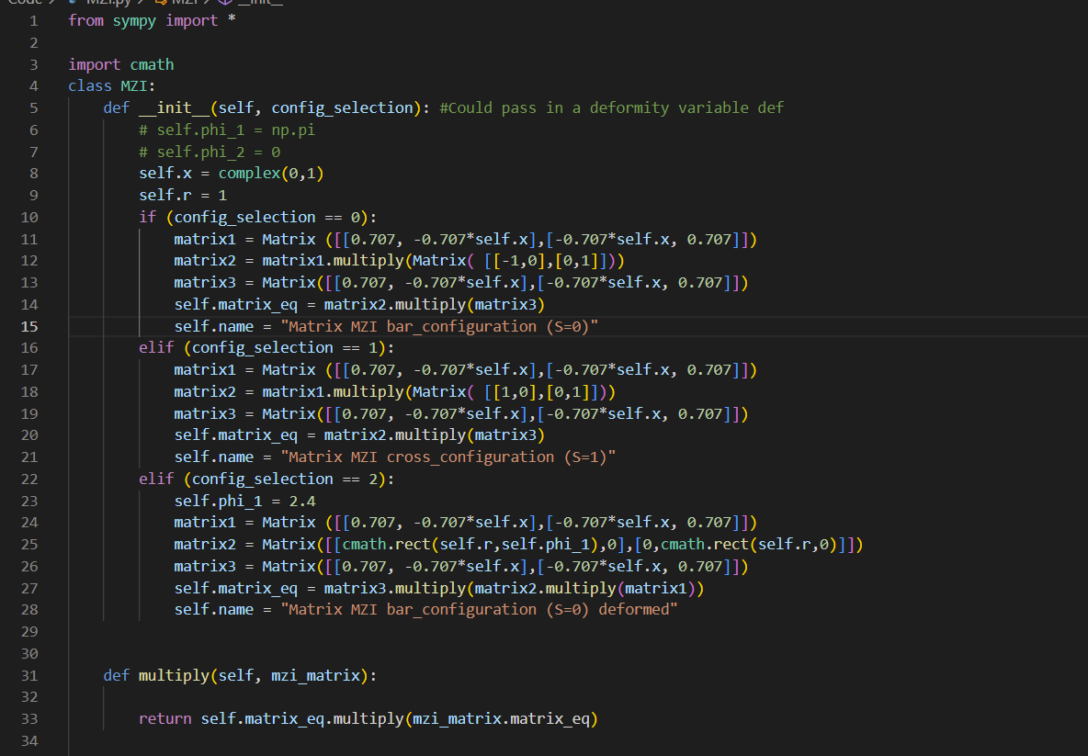
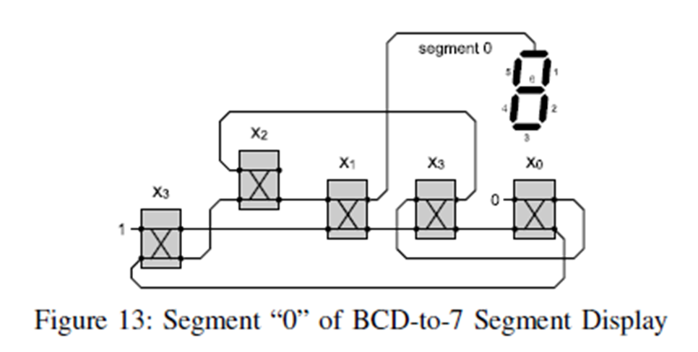
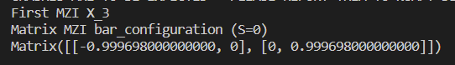
1st Experiment
Recreate this circuit with my structured python program.

Slide 11
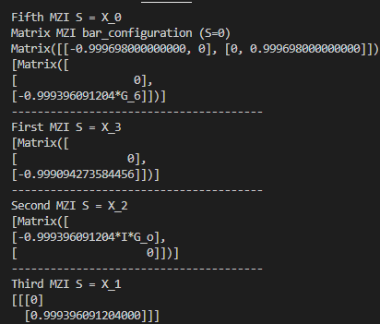
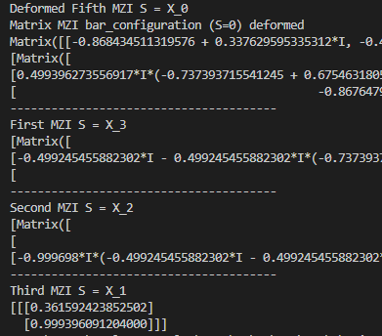
1st Experiment Cont..

Slide 12
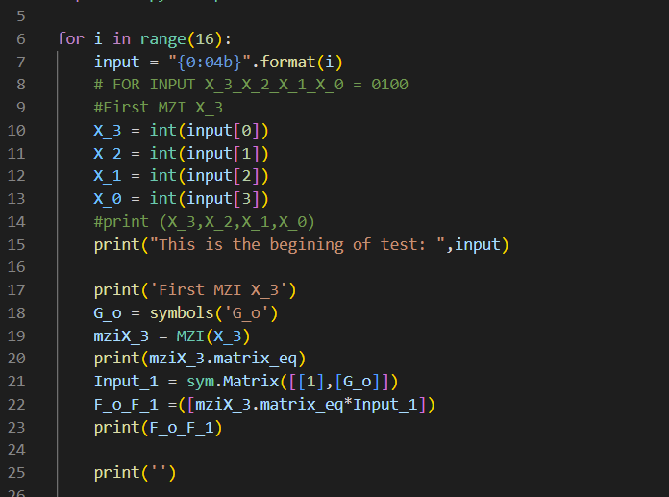
2nd Experiment
Now I am running through all 16 input entries for X_{0,} X_{1,} X_{2,} X_{3.}
Interested in seeing how the circuit will react
Dead loops
No Output

Slide 13
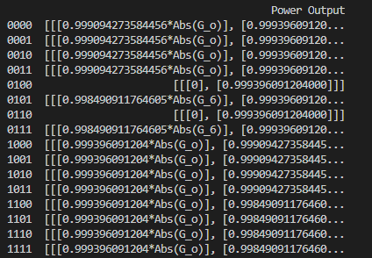
2nd Experiment cont..
Findings:
Dead loops
Working Inputs

Slide 14
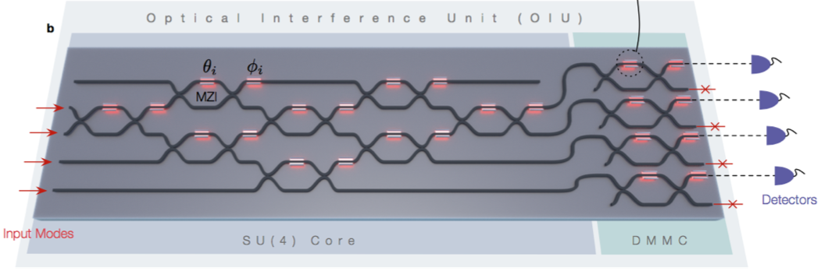
Conclusion
Useful tool to test more complex MZI circuits.
More robust ways of testing multiple S inputs for MZI’s.
Could be expanded to show the user a visual representation of their MZI circuit.
Could expand tool: Coupler, Beam Splitter, Phase Modulators, and Y-Splitters.

Slide 15
Thank You

